Slide 1
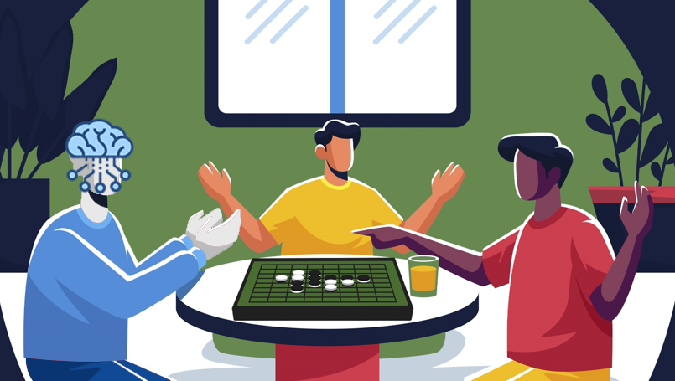
Deep Learning in Othello games Dissertation
“LUCIAN BLAGA” UNIVERSITY OF SIBIU
ENGINEERING FACULTY
Specialization: Advanced Computing Systems
Coordinator: Conf. dr. ing. Morariu Daniel
Graduate: Bărbulescu Adrian

Slide 2

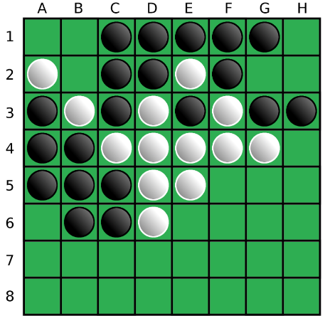
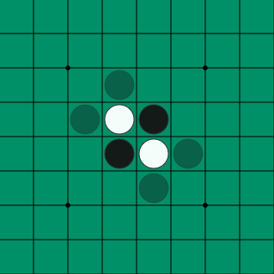
Introduction
What is Othello? A Shakespeare inspired game?
Othello, also called Reversi, is a strategy board game for two players, played on an 8×8 uncheckered board. The name was selected by Hasegawa as a reference to the Shakespearean play Othello, the Moor of Venice, referring to the conflict between the Moor Othello and Iago, and more controversially, to the unfolding drama between Othello, who is black, and Desdemona, who is white.
Notes:
What is Othello? A Shakespeare inspired game?
Othello, also called Reversi, is a strategy board game for two players, played on an eight by eight uncheckered board. The name was selected by Hasegawa as a reference to the Shakespearean play Othello, referring to the conflict between Othello, who is black, and Desdemona, who is white.
The rules of the game are pretty straightforward, the game traditionally begins with four discs placed in the middle of the board, two for white and two for the black player. Black moves first, black must place a black disc on the board, in such a way that there is at least one straight (horizontal, vertical, or diagonal) occupied line between the new disc and another black disc, with one or more contiguous white pieces between them.
After placing the disc, black flips all white discs lying on a straight line between the new disc and any existing black discs. All flipped discs are now black. White operates under the same rules.

Slide 3
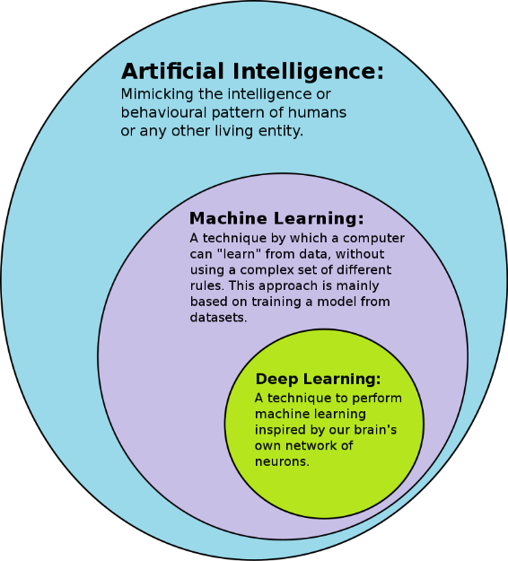
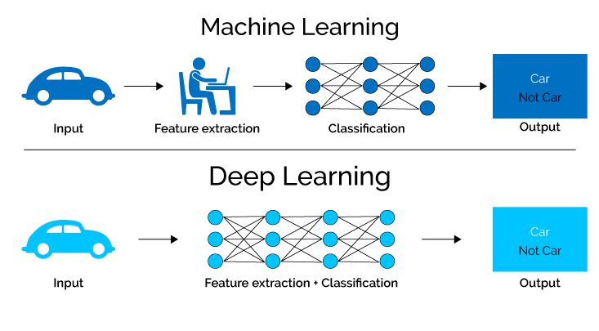
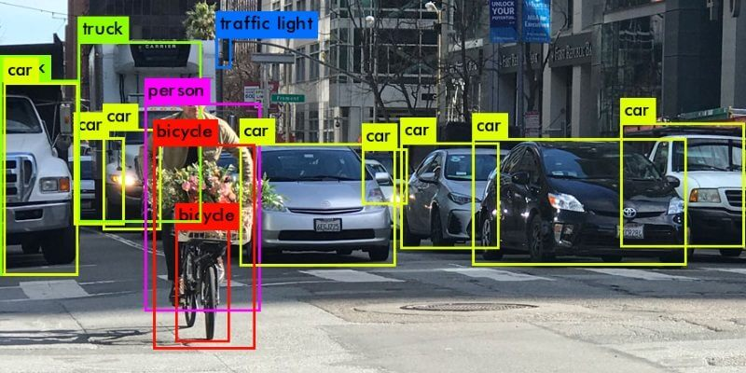

Introduction
Deep Learning
Deep learning (also known as deep structured learning) is part of a broader family of machine learning methods based on artificial neural networks with representation learning. Learning can be supervised, semi-supervised or unsupervised.
Convolutional neural networks (CNN/ConvNet)
Most modern deep learning models are based on artificial neural networks, specifically convolutional neural networks (CNN).
Notes:
Deep learning is part of a broader family of machine learning methods based on artificial neural networks with representation learning. Deep learning, the sub-class of machine learning, are used in many domains and have a broad set of applications in the real world like: image recognition, recommendation systems, mobile advertising and others.
Most modern deep learning models are based on artificial neural networks, specifically convolutional neural networks or convnet.
In this paper, I will present a state of the art deep learning method (using a convnet), combined with a stochastic method, implemented in an online adaptive system that will try to win against a computer opponent in the game “Othello”.

Slide 4
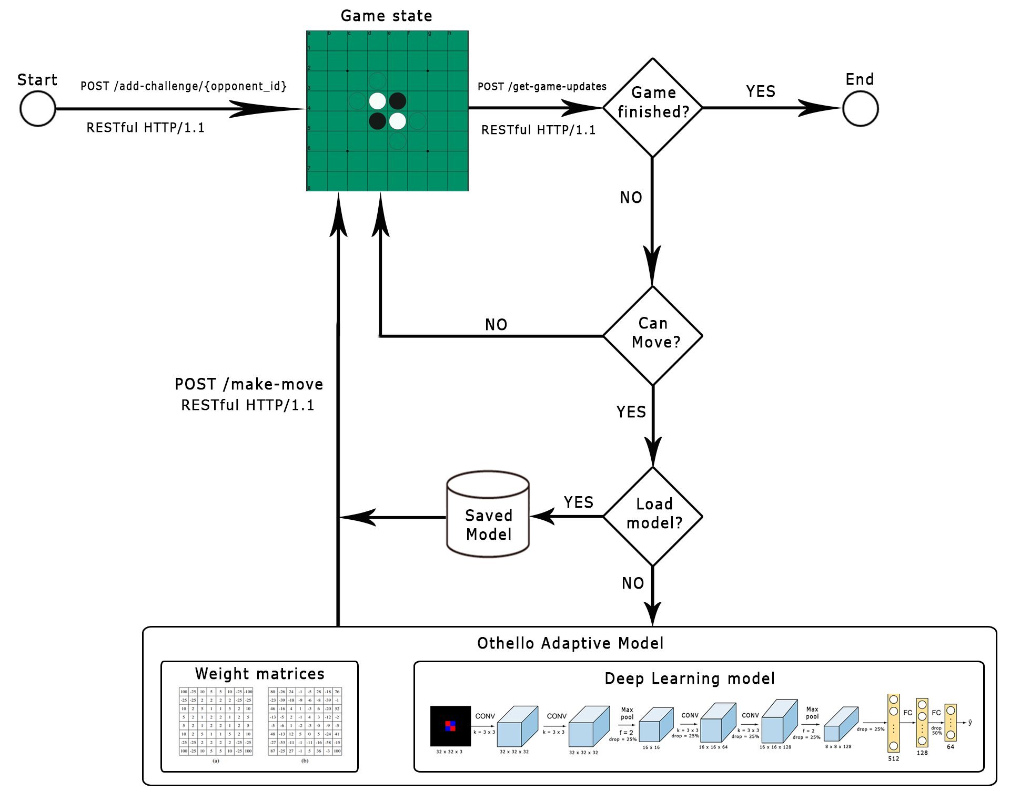

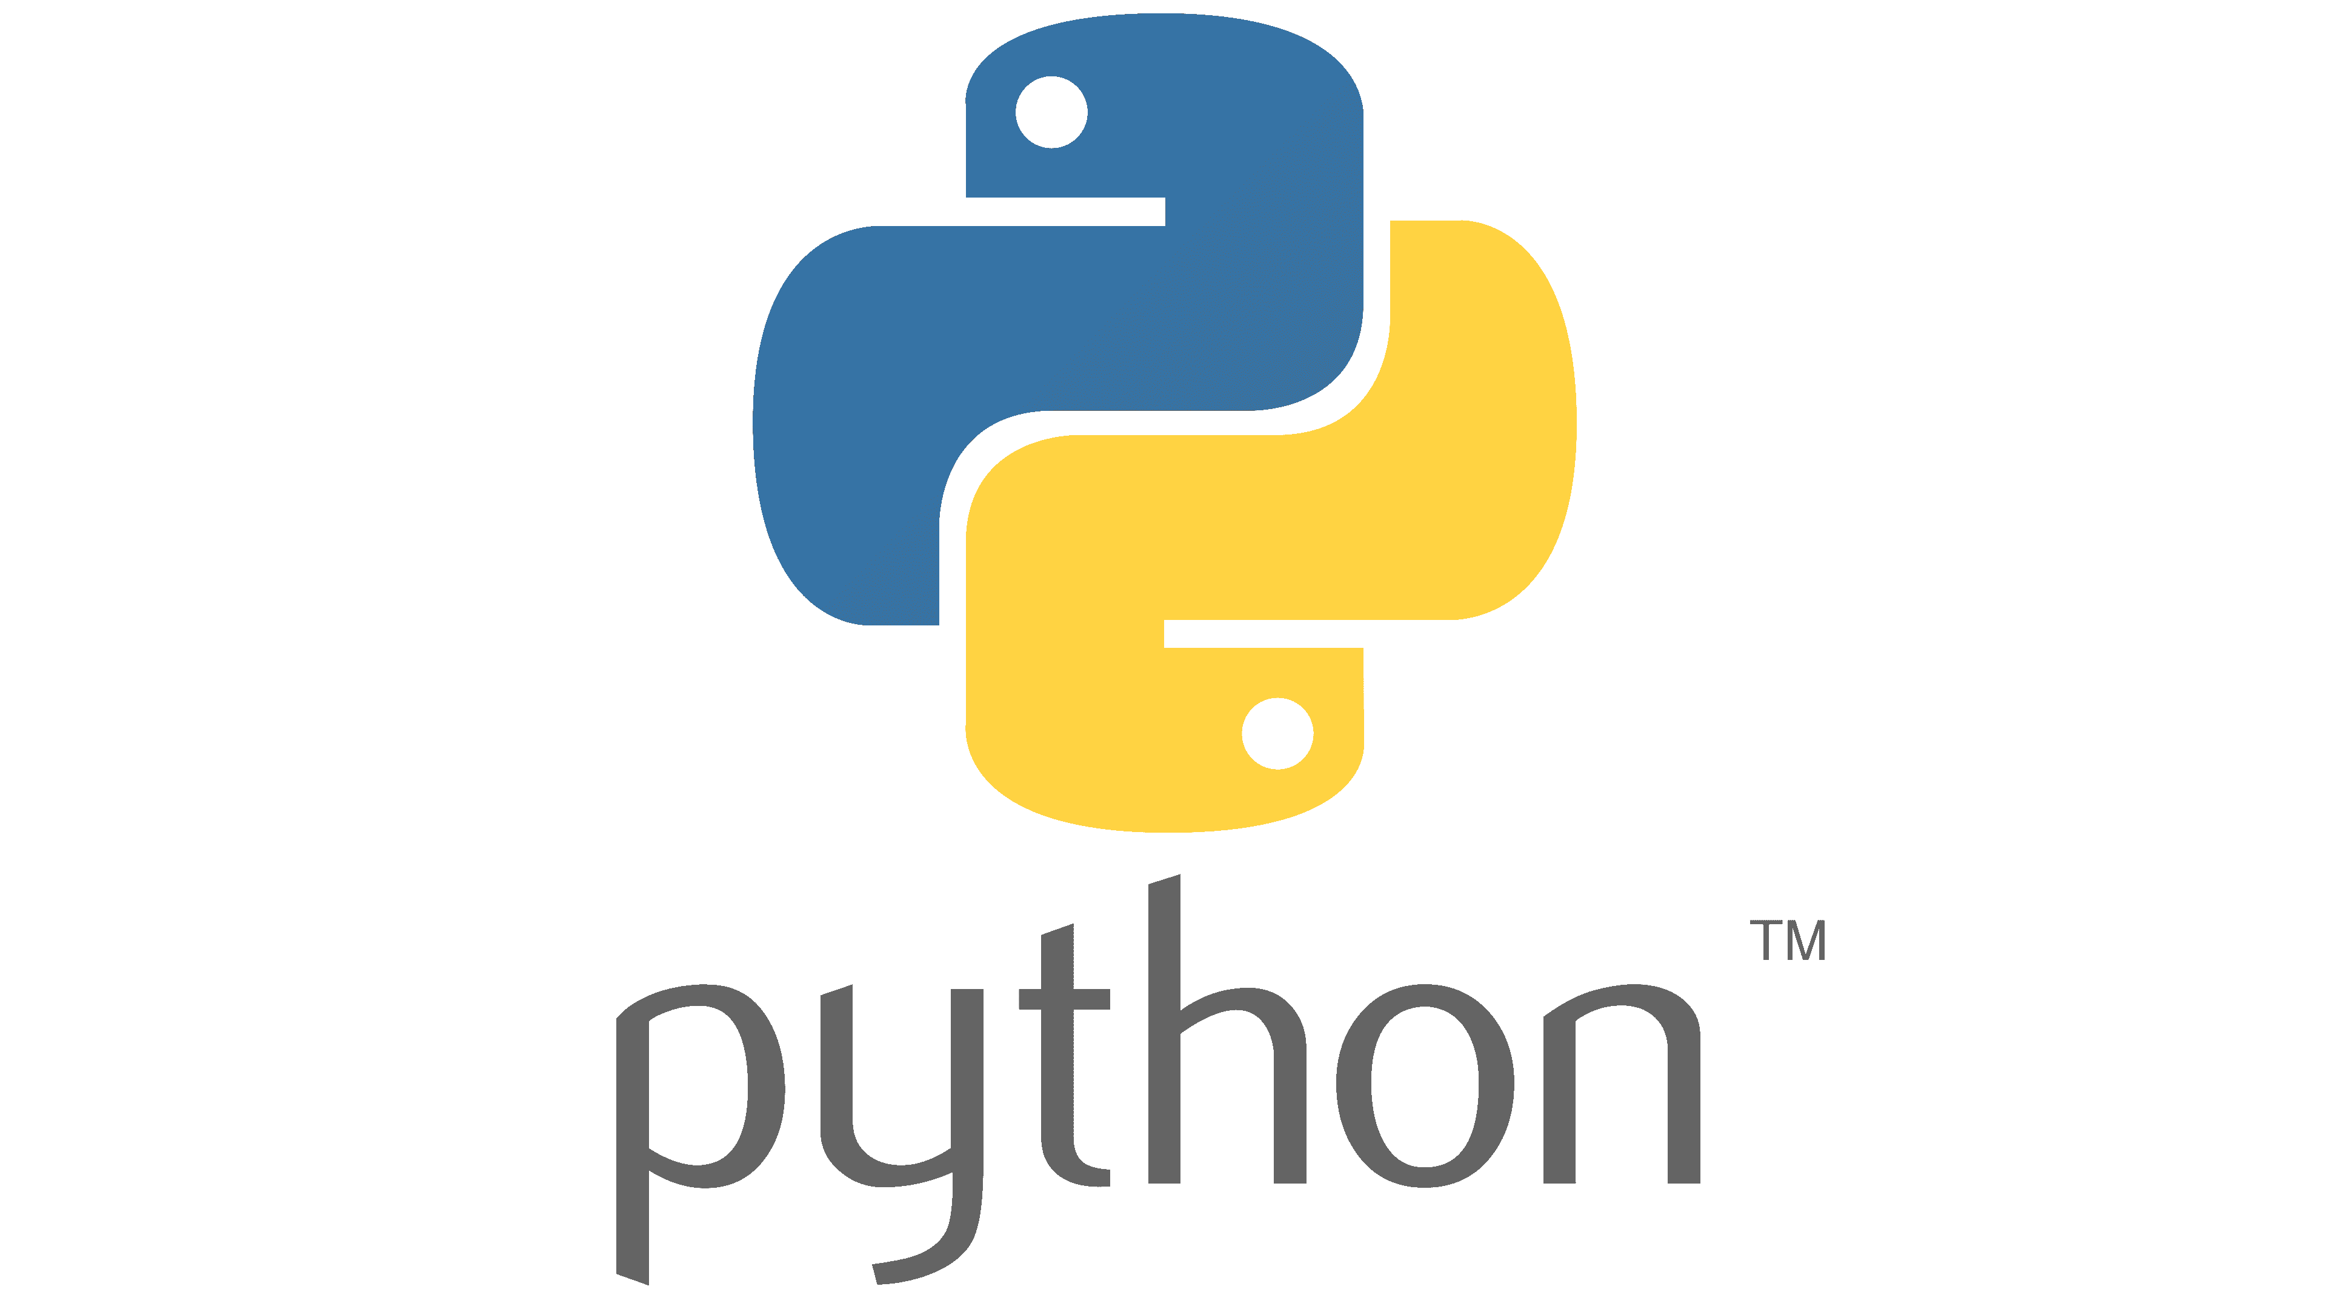

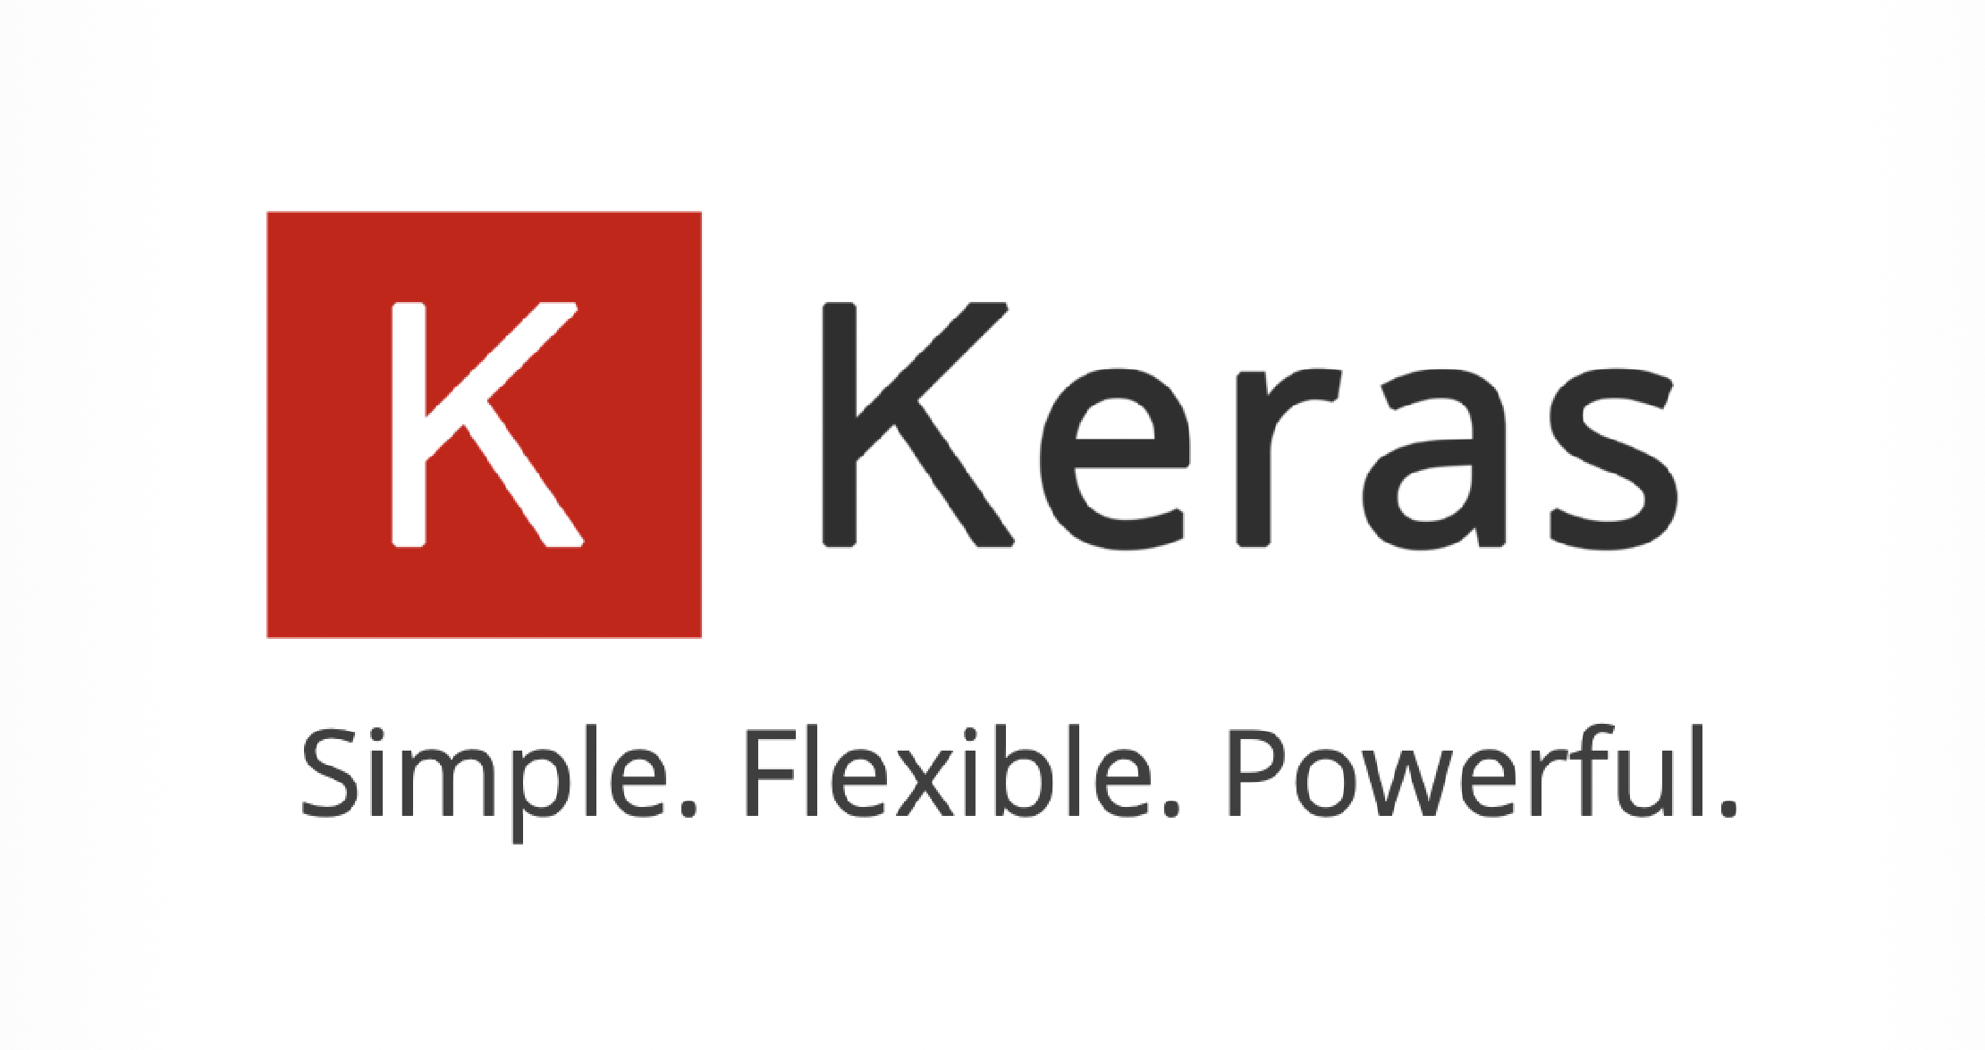
Architecture
The Adaptive model contains 2 sub-models:
The predefined weight matrices/tables
The deep learning model
Tools used:
Notes:
It can be seen in this figure that the system is mainly structured around the Adaptive Model and it uses three RESTful POST API methods to simulate the game on eothello dot com.
The adaptive model presented here uses two sub-models:
- The predefined weight matrices/tables which uses in memory saved tables to decide which move to take
And The deep learning model
The main program is implemented in Python using Tensorflow and keras for the Deep learning model, numpy and matplotlib for data manipulation.

Slide 5
Dataset
The deep learning model uses a collection of datasets from different sources for the learning process. The datasets are the following: a csv file from Kaggle with over 10000 games hosted on eothello.com, a dataset containing matches between professional Othello players and a dataset of matches played by our implementation of the adaptive model.
Example of a registered match in the pro matches dataset in the XML format:
<game-collection>
<game>
<event date="2004-05" name="yahoo japan"/>
<result winner="black" type="normal">51-12</result>
<player color="black" name="seeley ben"/>
<player color="white" name="suekuni makoto"/>
<moves game="othello-8x8" type="flat">f5d6c3d3c4f4c5b4c6e6f6b3a4g6g5h6e3f3g4h5h3g3e2d2d1c1b1e1f1c2f2e7d7f7e8b6b5a3a5a6f8c8d8g8h2c7b7g2b8a8a7g1h1h4b2a2a1g7h7</moves>
</game>
....
<game-collection>
Notes:
The deep learning model uses a collection of datasets from different sources for the learning process. The datasets are the following: a csv file from Kaggle with over ten thousand games hosted on eothello, a dataset containing matches between professional Othello players and a dataset of matches played by our implementation of the adaptive model.
When saving the information from the datasets, we are only parsing the result winner attribute (which can be black or white or draw) and the moves field text (which is a full string of symbols representing the cell in the board with a notation similar to chess), disposing the other redundant fields.

Slide 6
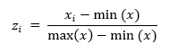
Pre-Processing
Preprocessing is the process by which data is cleaned and normalized, this being the most important step in a project working with machine learning algorithms.
This method implements file parser functions for the different dataset formats and makes conversion between the in-program board and the board from the eothello.com website.
Normalization
In the simplest cases, normalization means adjusting values measured on different scales to a notionally common scale, often prior to averaging.
Notes:
Preprocessing is the process by which data is cleaned and normalized, this being the most important step in a project working with machine learning algorithms.
This method implements file parser functions for the different dataset formats and makes conversion between the in-program board and the board from the eothello dot com website.
Another process in the pre-processing phase is the normalization step. We use normalization for the prediction phase in the predefined weight matrices model with the equation presented here.

Slide 7
Game API methods
3 RESTful API methods used to play on eothello.com:
Add a challenge
HTTP/1.1 – POST/add-challenge/{player_id}
Creates a game on eothello.com with the playerid specified in the request endpoint path.
Returns a game_id parameter.
Get game updates
HTTP/1.1 – POST/get-game-updates
Body format: game_id={X}&last_board_moves={Y}&last_chat_message_id=-1
This method allows the player to receive update about the state of the game.
Returns the server time, the turn for the player who should move, the winner if exists, empty otherwise, the previous moves played and the next update in milliseconds.
Make a move
HTTP/1.1 – POST/make-move
Body format: game_id={X}&move={Y}&move_index={Z}
This method allows the player to make a move on the board.
Returns the color of the player who has to move for the current turn.
Notes:
For our adaptive systems, we use three rest request methods to play a game on eothello dot com against another computer player created by them.
The first method, add a challenge, creates a game on eothello with the playerid specified in the request endpoint path. This request returns a game_id parameter to be used for the other requests.
The second method, get game updates, allows the player to receive update about the state of the game. It also uses the body format described here where game_id is the parameter returned from add a challenge request and the last_board_moves is the string of moves with the Othello notation until that point.
The last method, make a move, allows the player to make a move on the board.
Using these methods, we have all the necessities to play a game using their API.

Slide 8
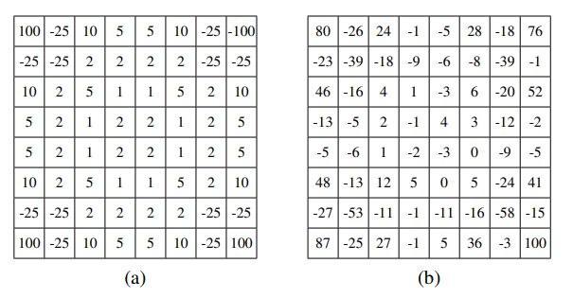
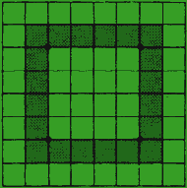
The Predefined Weight Matrices Model
Dangerous zones to place a disk (dark green):
a) Heur, b) Bench weight matrices
Notes:
A team of researchers came with two performant tables that solves the problem of thinking on which is the best position to capture on board, based on a value of that position called position weight value, positive value representing a better position and negative values representing a worse position to place the disk.
These tables are called Heur & Bench matrices.
Although, these tables are different, they are both reduced to the main idea, prioritizing the corner, avoiding the dangerous zone and playing a strategical game of controlling the middle.

Slide 9
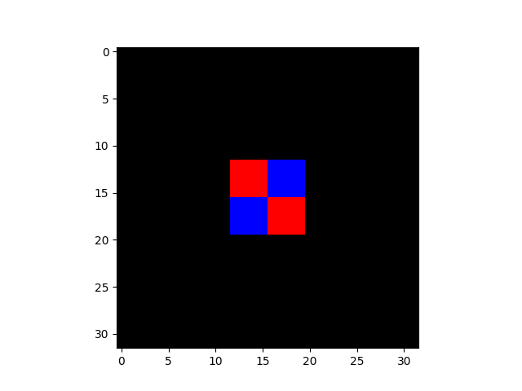
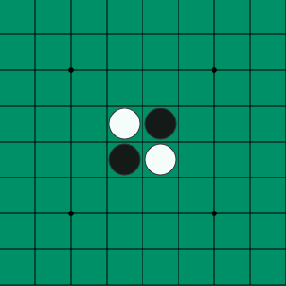
Learning Model Setup
Initial Othello board setup (plotted as a NumPy array):
Learning values setup:
Initial Othello board setup:
model_type='4conv-layer’,
batch_size = 32,
epochs = 25,
max_loaded_matches = 3000,
split_validation = 0.8
optimizer = keras.Optimizers.Adam()
Notes:
For the deep model to learn and function, we need to feed it an input image of the size specified before the training phase. The image can be a numpy double dimension array, that contains a three value array which represents the color channels for red, green and blue. We implemented the disk color of white as red, the disk color of black as blue and the empty board as black for the numpy array, shown in this figure.
Before using this model, we also need to think of the predefined learning values used in the training phase, for example the batch size, the number of epochs and other parameters. We created a config file with the parameters presented here.

Slide 10
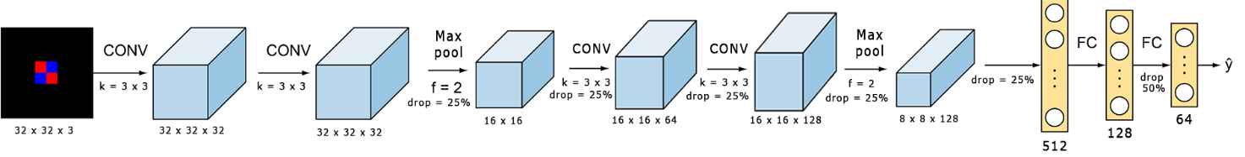
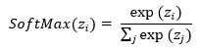
The Deep Learning Model (ConvNet)
Activation functions:
Notes:
In this figure, we can see the deep learning model implemented in the adaptive system.
We use four convolutional layers with different filter sizes, a size of three for the kernel matrix, two max-pool layers with a matrix size of two and different dropout node values with the ReLU activation function between all the convolutional layers. For the neural network, we use an input layer with five hundred twelve nodes (all flatten beforehand from the convolutional layer), followed by a hidden layer with one hundred twenty eight nodes and an output layer with sixty four nodes that uses the SoftMax activation function.
The model basically takes an image of the board when the current player is on turn to move, computes the best move based on the training data and returns the probabilities of all the sixty four positions on the game board. The model is trained only with winning games, taking every state of the board when the supervisor player moves as an input image, together with the correct next move played by the same supervisor as an output number representing the board position.

Slide 11
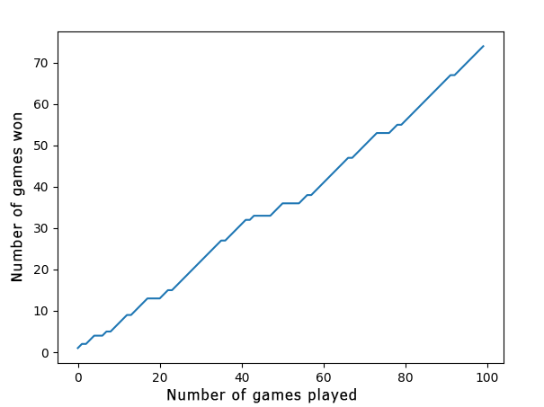
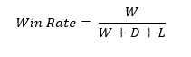
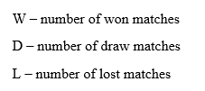
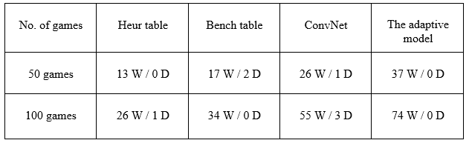
Results
Notes:
When testing the deep learning model, the final accuracy was equal to approximately fifty five percent. This is not the best accuracy for this model and can be further improved.
In this current plot figure, the adaptive model won seventy-four games, from the total of one hundred games played, quite good considering we don’t track the rules in the models.
We can also see that the Heur and Bench tables don’t perform that good when used independently, but by combining them with the deep learning model, we can acquire a better win-rate.

Slide 12
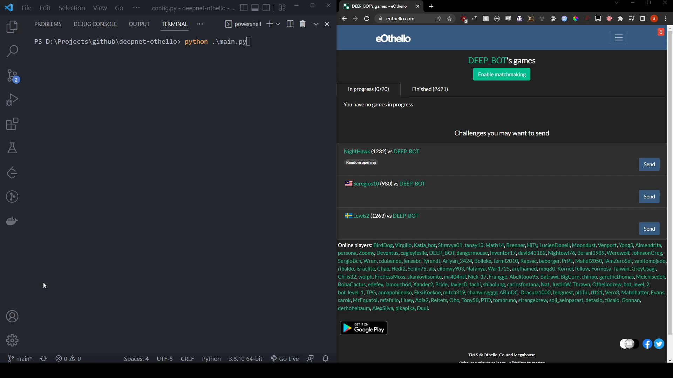
Demo
Notes:
The model plays as black

Slide 13
THANK YOU!
Any questions?

